Slide 1

WELCOME
Mobile Application Development

Slide 2
Key Points
What is Android?
What is Operating System?
What is Linux?
What is Open Source?
Overview
The Superior College Mian Channu

Slide 3


android Introduction
Android is an open source and Linux-base Operating system.
Developed by the open Handset Alliance, led by Google and other companies.
Google has further developed Android TV for television, Android Auto for cars and wear OS for wrist watch.
Superior College Mian Channu

Slide 4
android Introduction
Open Source Linux Based Operating System
A B C
Superior College Mian Channu

Slide 5
What is operating System?
An operating system or OS is a software program that enable the hardware to communicate and operate with the software.
Operating system is an interface between user and hardware.
Operating systems provide a software platform on top of which other programs, called application program can run.
Superior College Mian Channu

Slide 6
What is Linux?
Linux is a family of free and open source software operating systems built around the Linux kernel.
The development of Linux is one of the most prominent examples of free and open-source software collaboration.
Superior College Mian Channu

Slide 7
What is open source?
The source code of a computer program is made available free of charges to the general public.
Users can view the code that comprises the software and make any kind of changes to it they want.
Anyone can take the source code and distribute their own program from it
Superior College Mian Channu

Slide 8
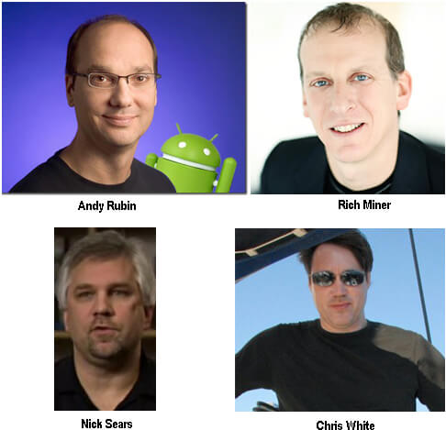
History of Android
.
Superior College Mian Channu

Slide 9
Android Inc?
Initially, Andy Rubin founded Android Incorporation in Palo Alto, California, United States in October, 2003.
In 17th August 2005, Google acquired android incorporation. Since then, it is in the subsidiary of Google incorporation.
Superior College Mian Channu

Slide 10
Key Dates
October 2003- Android Inc. was founded.
July 2005- Google acquired Android Inc.
October 22nd , 2008- First android smartphone HTC Dream was launched.
The latest android version is Android 15 and it was released on September 2, 2024. The internal code name for Android 15 is Vanilla Ice Cream.
Superior College Mian Channu

Slide 11
Android Versions
The first commercial version, Android 1.0 was released on September 23, 2008.
Android code names are confectionery (Sweets & chocolates)- themed and have been in alphabetical order since 2009’s Android 1.5
Superior College Mian Channu

Slide 12
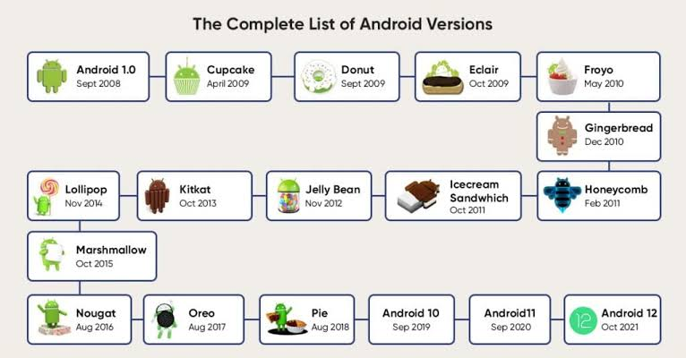

Slide 13
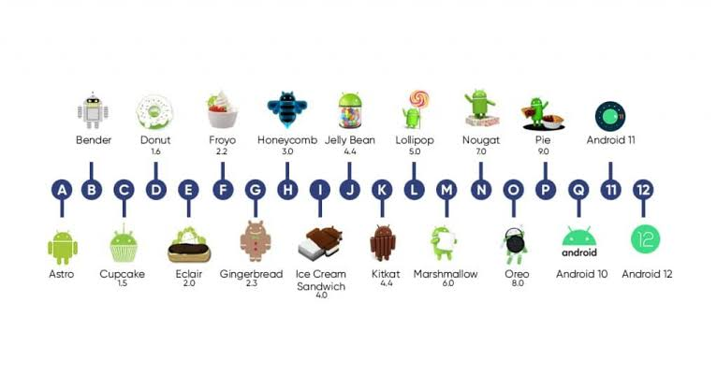

Slide 14
What is IDE?
Integrated Development Environment
Superior College Mian Channu

Slide 15
What is IDE?
Enables programmer programmers to consolidate the different aspects of writing a computer program.
Increases Efficiency- faster coding with less effort.
Superior College Mian Channu

Slide 16
Main Feature of IDE
Editing source code.
Syntax Highlighting.
Autocomplete(Suggestions).
Building Executables.
Debugging (Manual Testing).
Superior College Mian Channu

Slide 17
Thank You

